Slide 1
Final Project: IE-600 Google Stock Price Predictions
Akshay Sanjay Agrawal

Slide 2
Problem Statement
Predict the opening stock prices of Google for investment strategies

Slide 3
Data:
Source: Yahoo Finance : https://finance.yahoo.com/quote/GOOG/history?p=GOOG
Variables: Opening, Closing, Minimum, High, Volume
Input: Closing Prices
Output: Future Prices
Dates: 2012-2016
Predictions for 2017 January

Slide 4
How to tackle:
Moving Average(MA)
Auto Regressive(AR)
ARMA
ARIMA
LSTM-Long-Short-Term-Memory

Slide 5
Why RNN?
No Assumptions about the data: It can be non-linear
Weights are optimized
No need to have stationary Series: Major drawback of classic methods

Slide 6
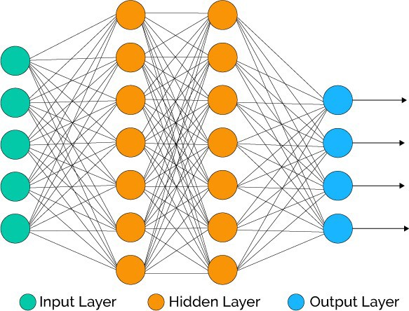

Recurrent Neural Networks: Sequential Neural Nets
Keras API: https://keras.io/layers/recurrent/
Drawbacks: Lack of knowledge retention-unable to learn long term dependencies

Slide 7
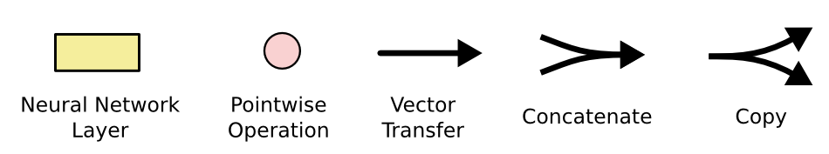

LSTM: Special type of RNN Designed to learn long-term dependency
http://colah.github.io/posts/2015-08-Understanding-LSTMs/
http://primo.ai/index.php?title=Long_Short-Term_Memory_(LSTM),_Gated_Recurrent_Unit_(GRU),_and_Recurrent_Neural_Network_(RNN)

Slide 8
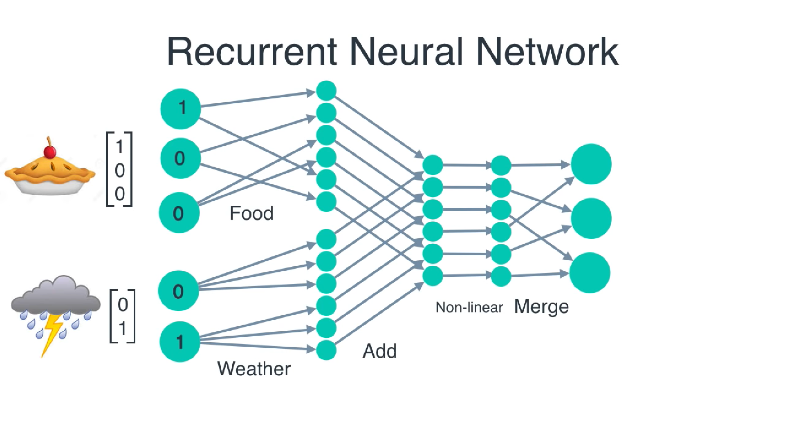
Example: Epoch and Batch Size?

Slide 9
Step 1.A: Data Pre-processing
After the Data Import:
Feature Scaling is important. Why? bigger computations ,time, wrong results.
Two ways: Standardisation and Normalisation
For RNN, Normalization is recommended

Slide 10
Step 1.B: Reshaping and Splitting
Split the train and test sets
Reshape matrices for feeding to Network

Slide 11
Step 2. Building Model
Import packages and libraries
Define your layers, their inputs, their outputs, number of epochs, Batch Size
Batch Size=1 → Stochastic Gradient Descent, else → Gradient Descent
Compile the RNN, specify the optimizer: RMS Prop recommended for RNN, Here(adam)
To avoid overfitting, drop some neurons

Slide 12
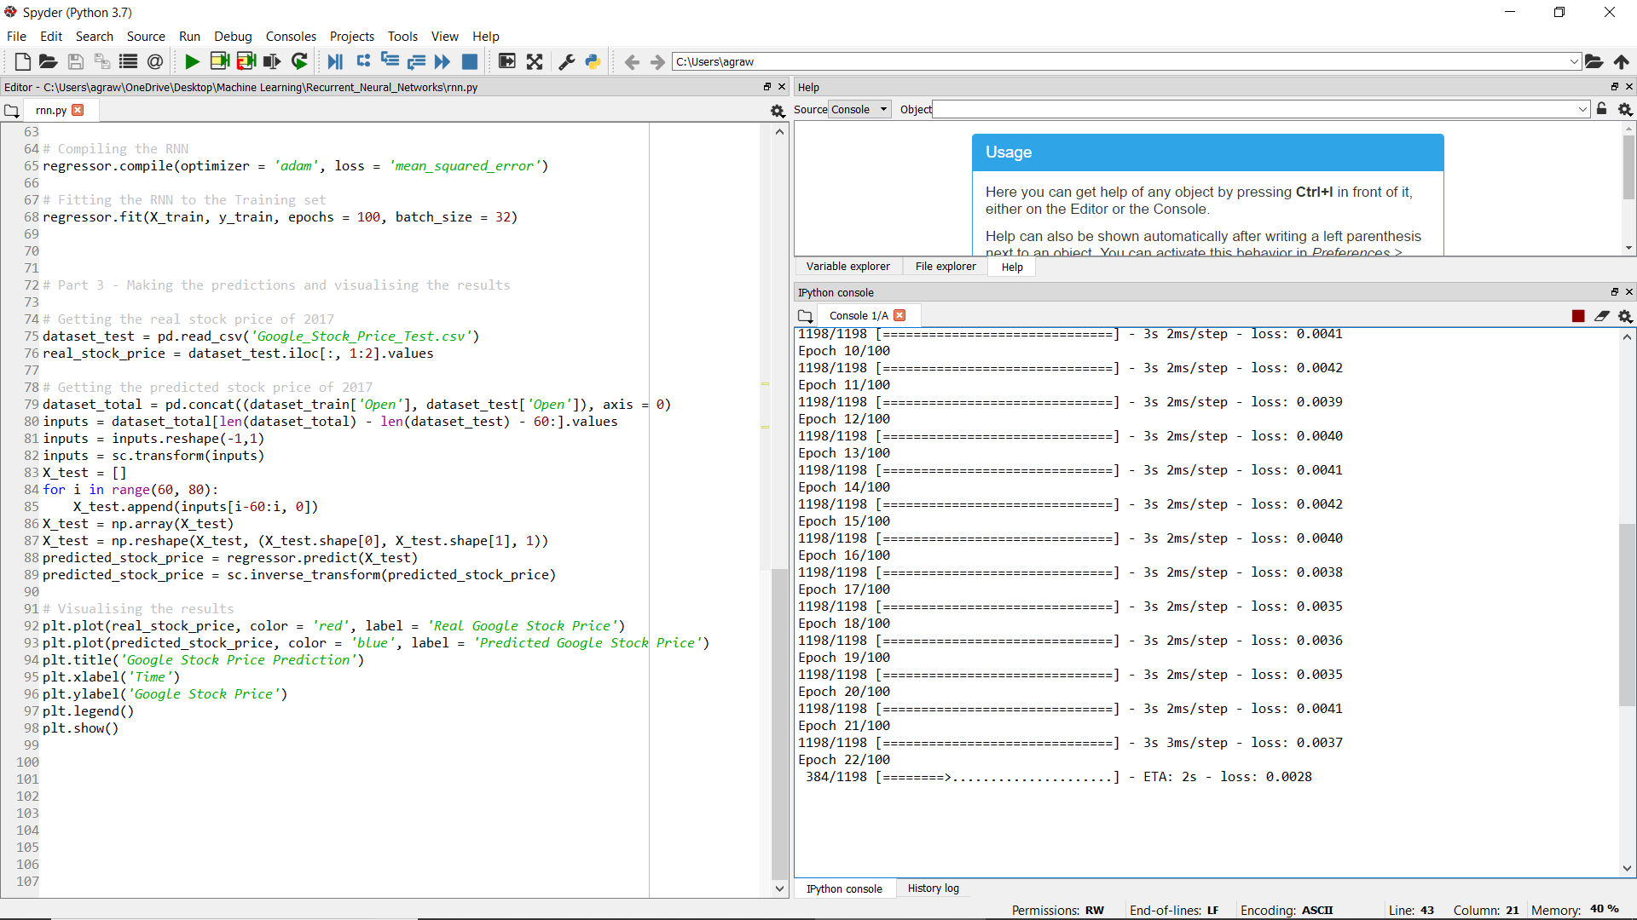
Step 3. Model Training
Train the model: wait for convergence of the loss function. If not, tune the parameters

Slide 13
Step 4. Model Testing
Scale the test inputs.
Get the results and then inverse transform

Slide 14
Step 5. Model Evaluation
Cost Function: RMSE

Slide 15
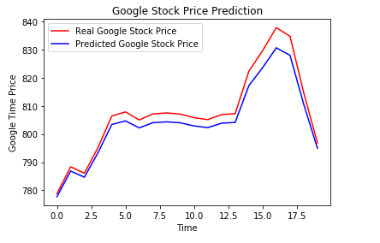
Visualize the results
See for overfitting and underfitting

Slide 16
Parameter Tuning
Change epoch, batch size
Change optimizer
Dropping neurons
Change number of neurons

